Slide 1
Wellbeing economics and Geopolitics
February 2024
Gaya Herrington

Slide 2
Hello
Gaya Herrington
Published author & public speaker on systemic sustainability issues and wellbeing economics
Vice President Sustainability Research, Schneider Electric
Club of Rome Advisor
Master in Sustainability from Harvard University, and a Master in Econometrics from the Free University Amsterdam

Slide 3
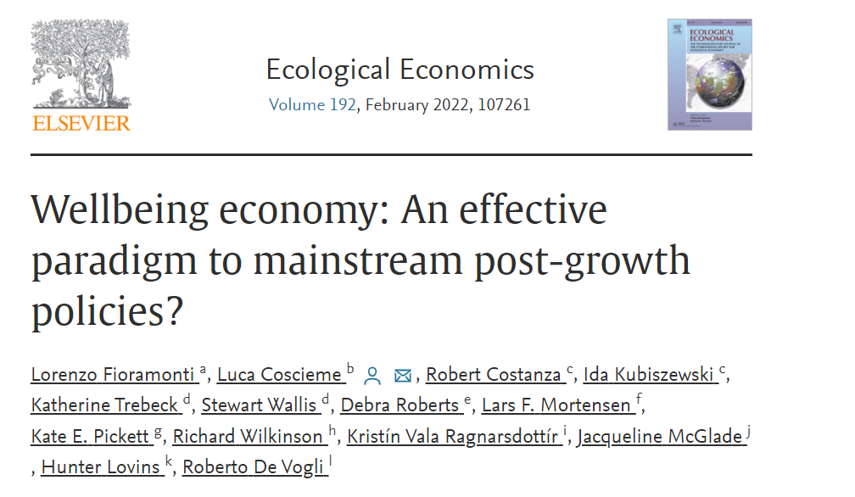
Wellbeing Economics
Replacing the pursuit of growth (in profits or GDP) with human wellbeing within ecological limits
“A Wellbeing Economy is an economy designed to serve people and the planet, not the other way around. Rather than treating economic growth as an end in and of itself and pursuing it at all costs, a Wellbeing Economy puts our human and planetary needs at the centre of its activities, ensuring that these needs are all equally met, by default.”
Wellbeing Economy Alliance

Slide 4
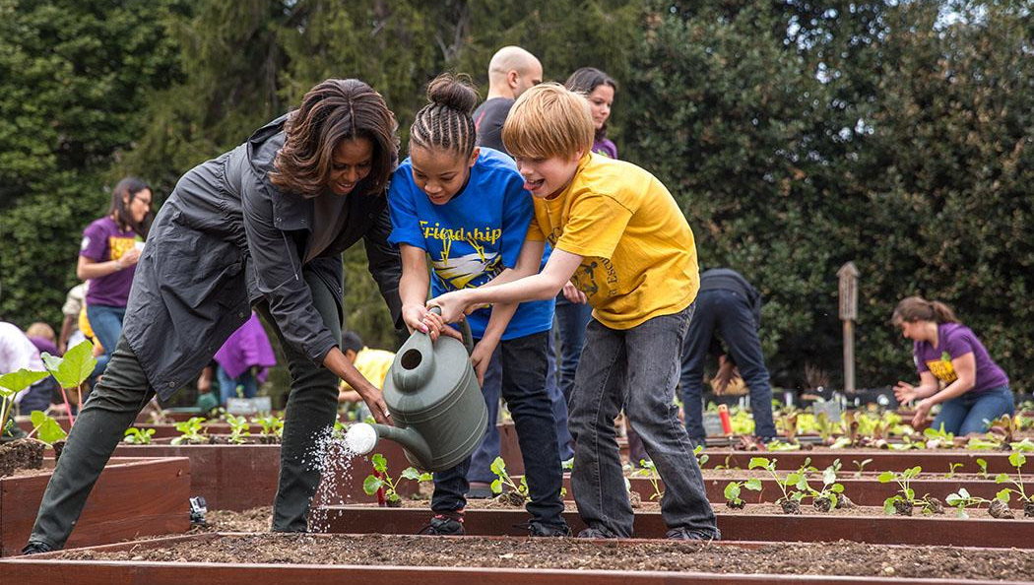
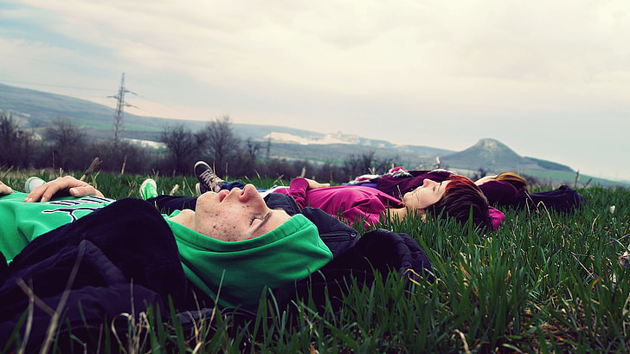
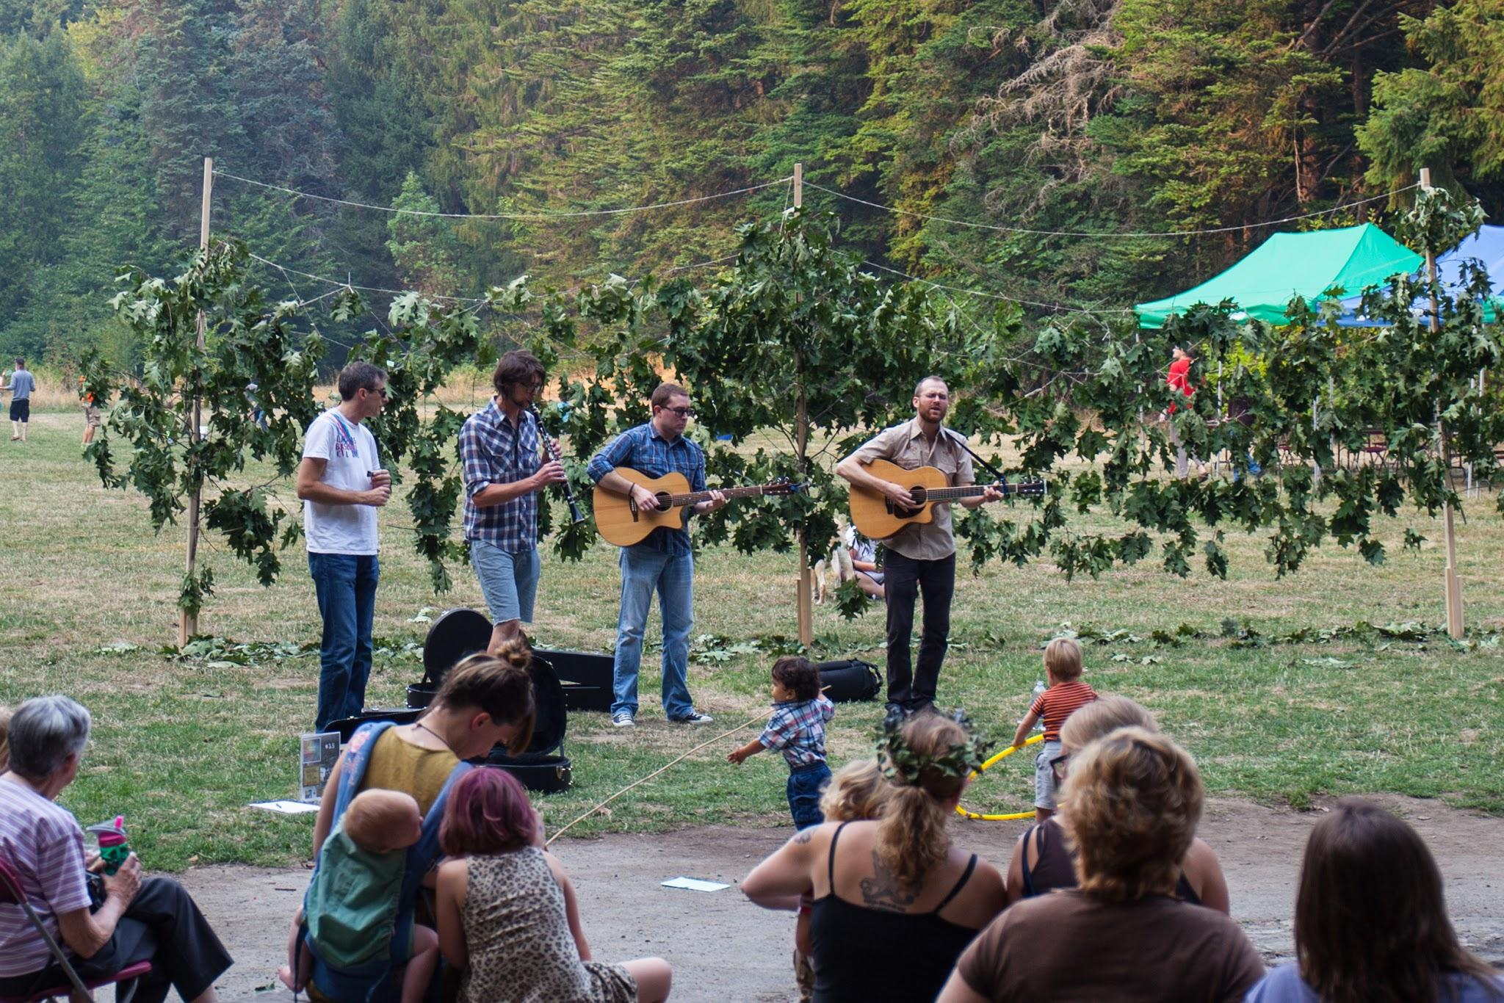
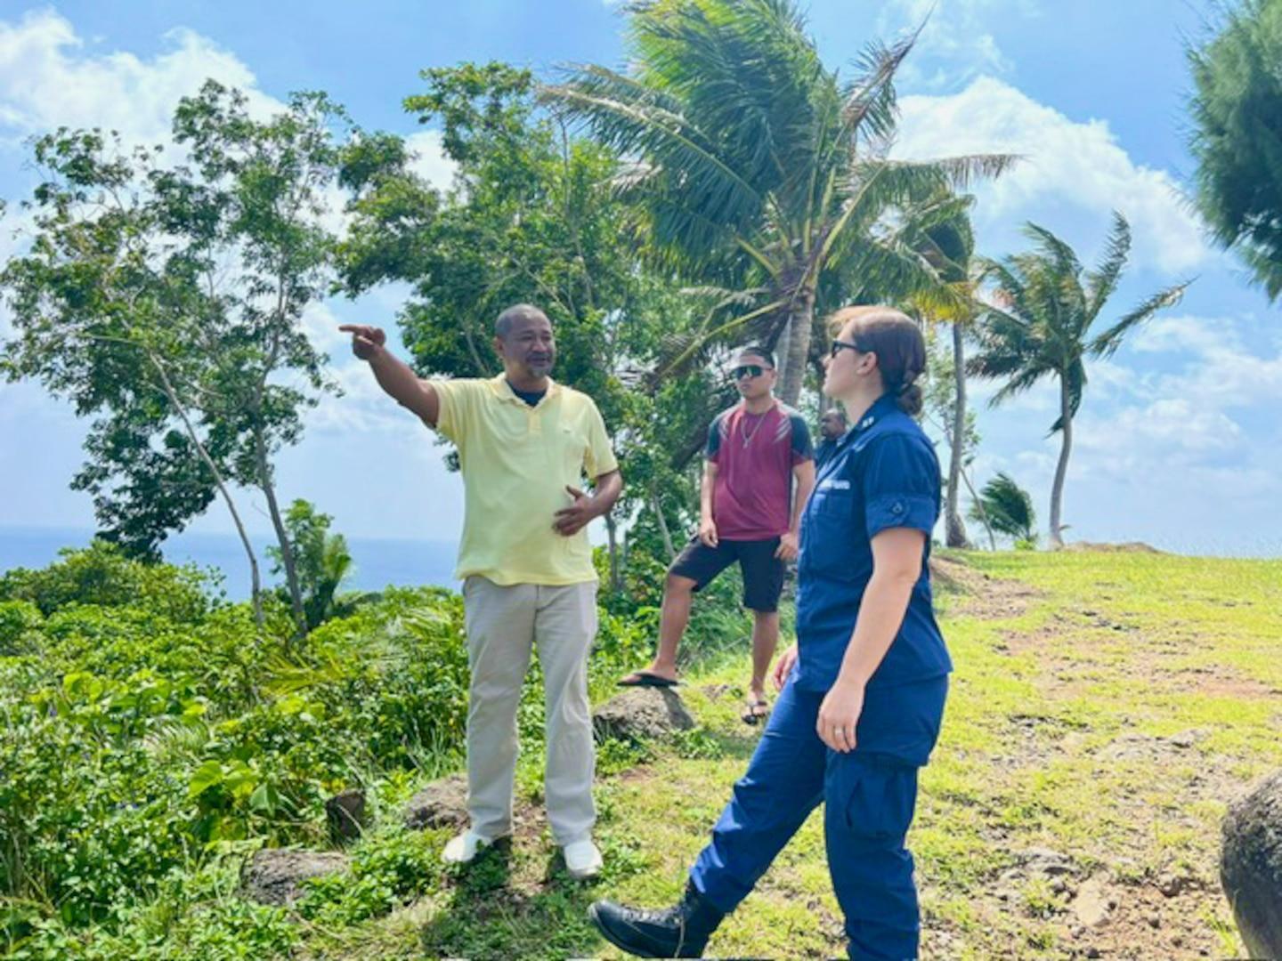
Concretely
A society where needs are met through low-impact ways and resources are shared much more equally. This is a place with:
A shorter workweek and more meaningful jobs
Food locally grown with knowledge of environment, seldom wasted
Clean energy and unpolluting or even regenerative products
Strong community through sharing of tools, toys, and leisure activities.
Better mental and physical health as a result.
Conviviality, generosity, and fun!

Slide 5
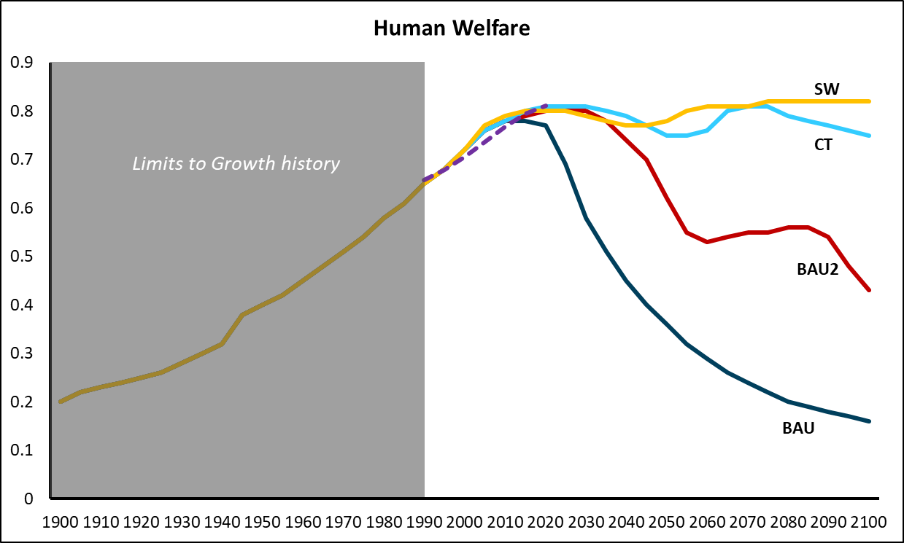
Keep in mind
Continuing
business as usual
is not an option.
Empirical data (UN Human Development Index) plotted against human welfare variables for all four scenarios. See my book for all graphs, datasets and details on methodology.
Notes:
What worked in the past will not work going forward.
Social capital might be bigger in wellbeing economies, which is a major factor for innovation and also defensive capabilities.
Innovation does not come from growth, it comes from people with access to the education they want working together.

Slide 6
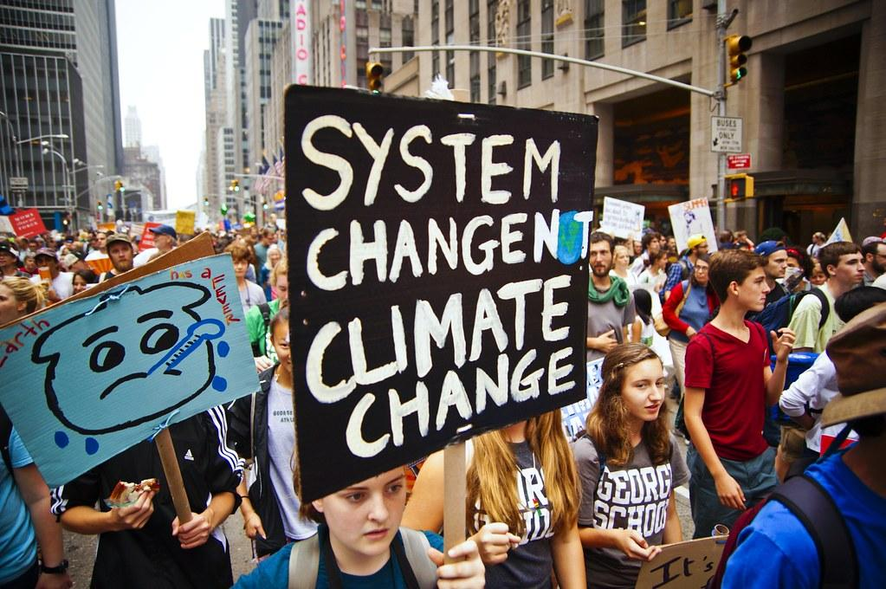
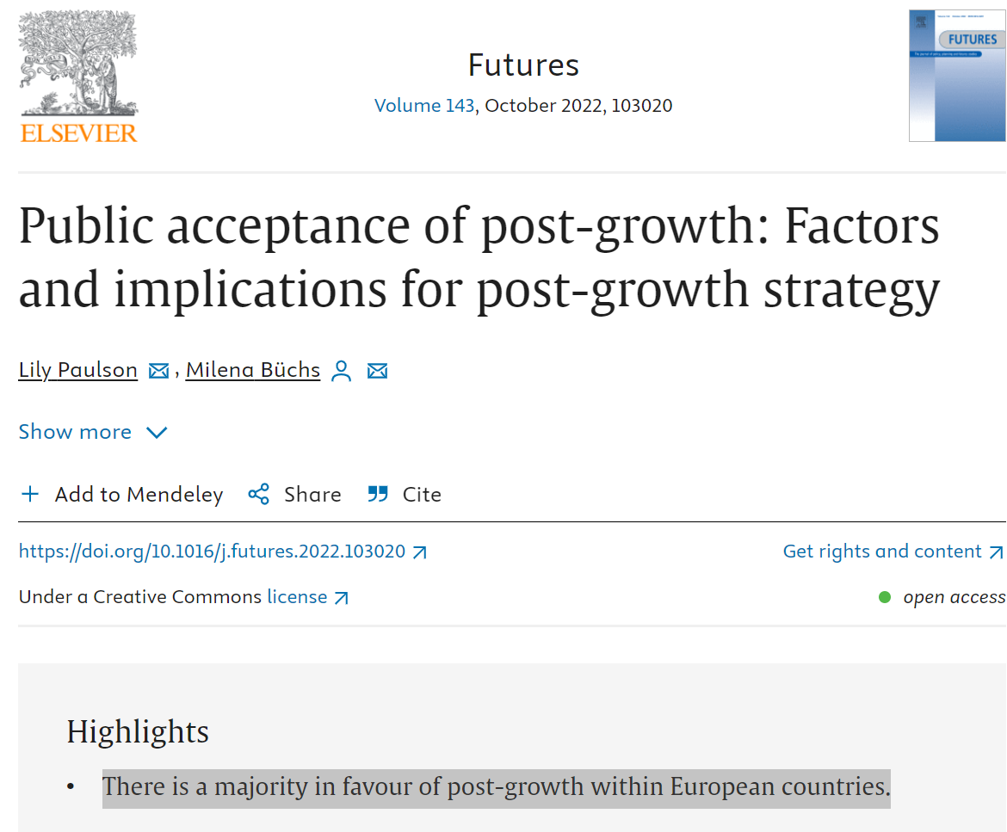
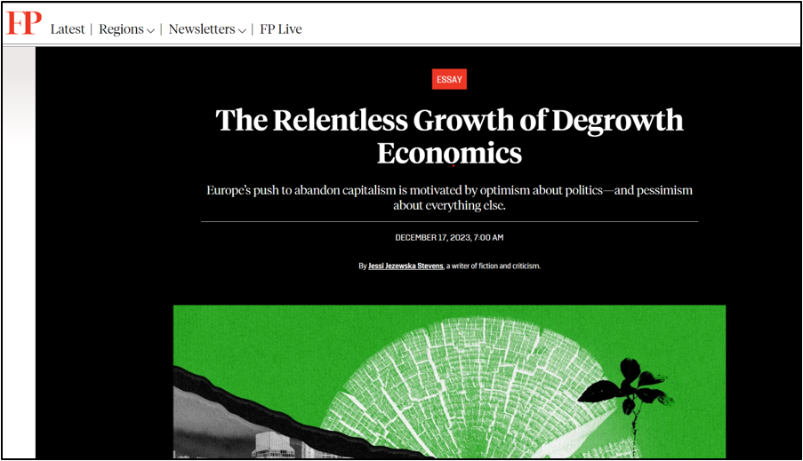
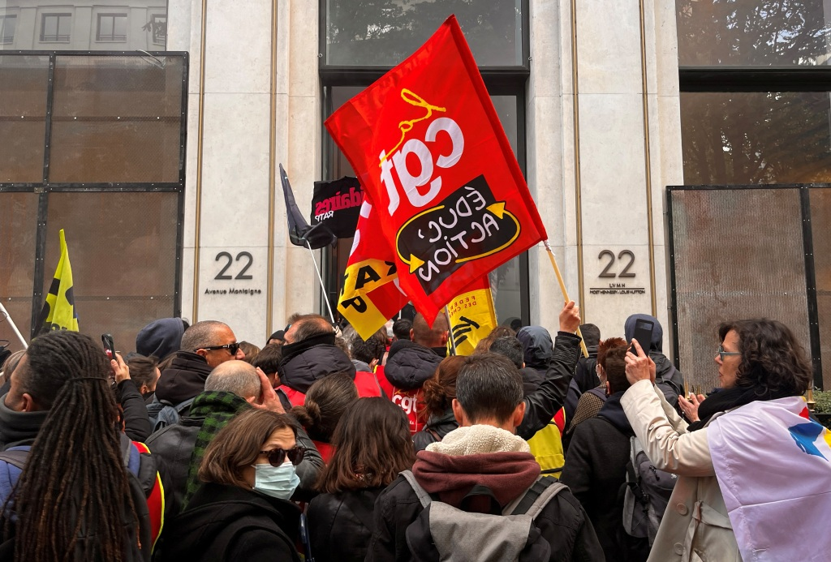
Social Capital
Surveys show that wellbeing economics values and policies are popular, and that the majority of the world population seems ready for deep systemic changes*.
While current growth-based economics is destabilizing not just ecosystems but societies. This is also a geopolitical risk.
The “majority of respondents are losing faith in the capitalist system”, says 2020 Trust Barometer.
American youth today is more often positive about socialism than about capitalism.
Three in four people in G20 countries are aware that Earth is approaching tipping points and support deep systemic changes towards prioritizing health, well-being, and the planet.
In Japan, a “Marxist, post-capitalist, green manifesto” ─ in which the author K. Saito advocates for things like shorter working hours, sharing wealth, and prioritizing caregiving ─ has become a bestseller.
The majority of people in advanced economies want deep reforms in their political and economic systems.
Notes:
Stability will not be bigger in society’s that stay growth-based while growth will become ever more difficult to obtain.
So just as easily one could ask the opposite question: Can a country still defend itself if its growth-based economy is exhausting its natural capital and fraying its social cohesion (think of Ukraine war)?

Slide 7
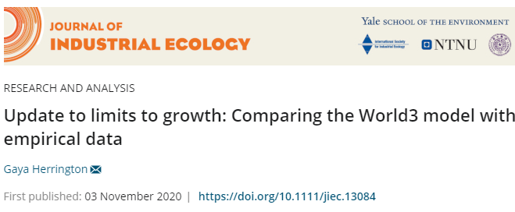
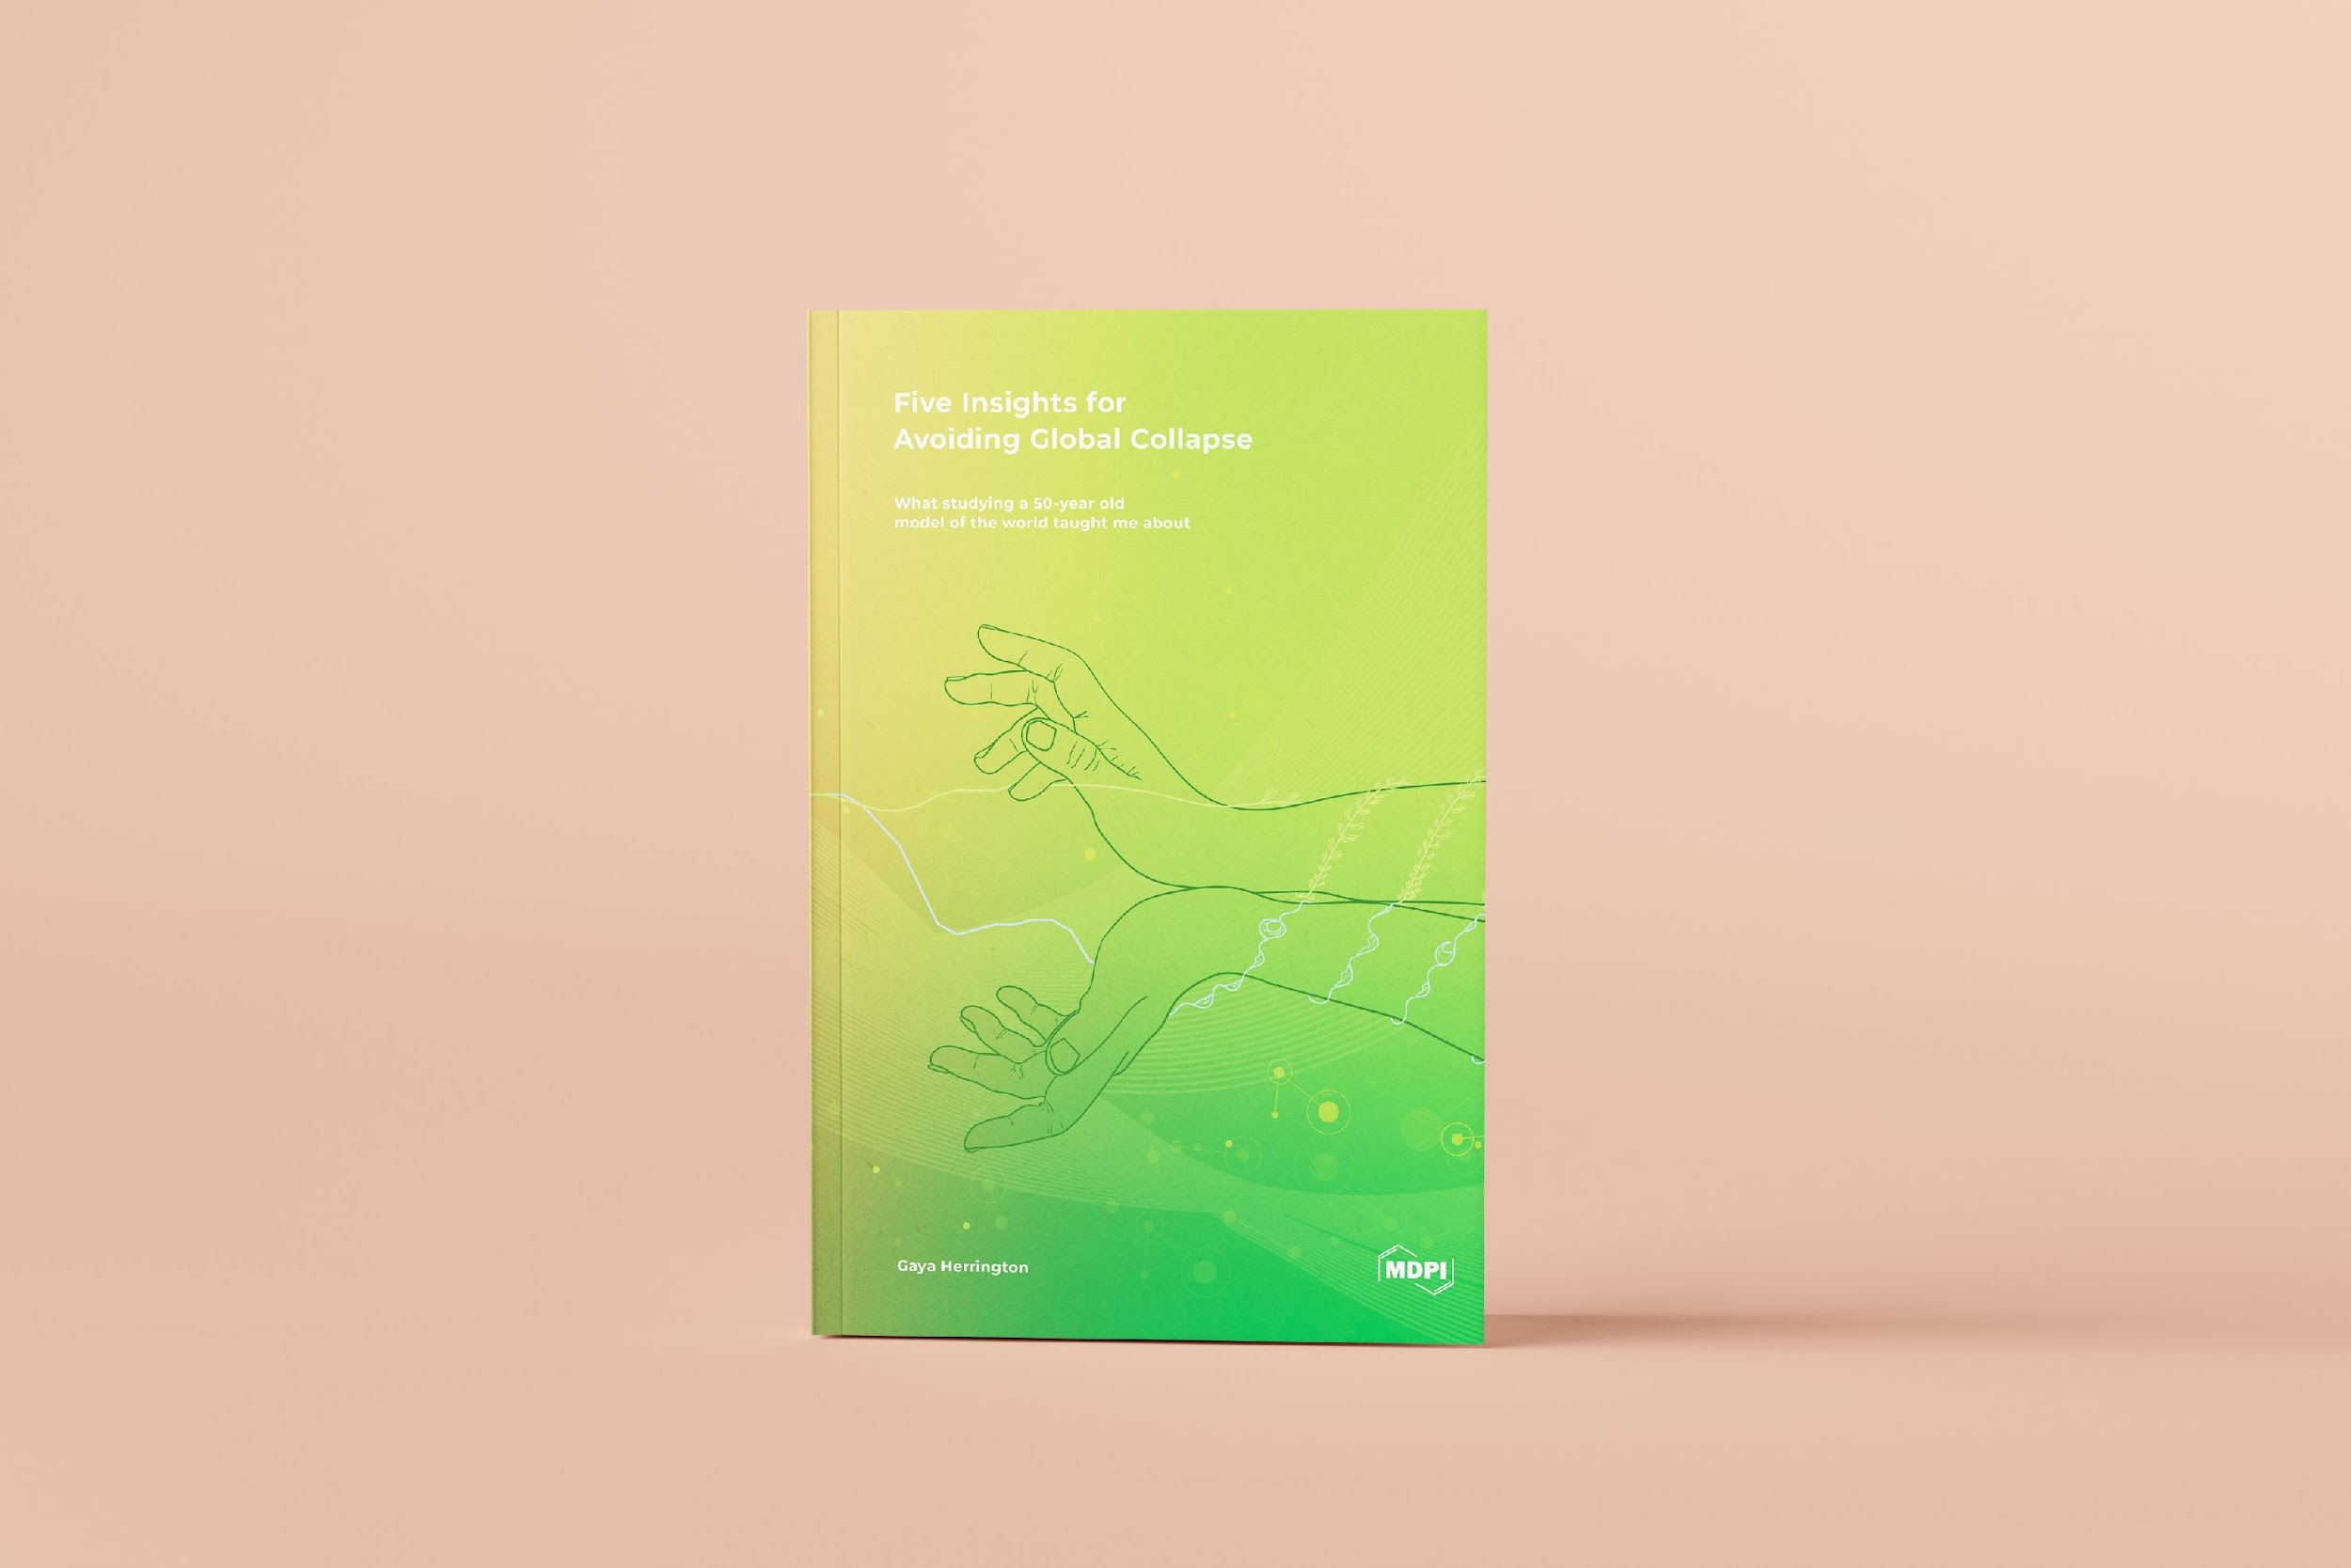
Thank you!
Other links
LinkedIn: https://www.linkedin.com/in/gayausa/
Popular interviews: https://www.wired.com/story/gaya-herrington-avoiding-global-collapse/ and https://untoday.org/we-are-working-in-a-complex-system/
Popular Keynote speech: https://www.youtube.com/watch?v=PTu0X_PesrY
1 hour lecture series about postgrowth economics (pay wall but free with trail): https://sustainabilityunlocked.com/discover/experts/gaya-herrington
2020 empirical update to The Limits to Growth, published in Yale’s Journal of industrial ecology.
2022 update available in my book, including more background research.
Open Access online under Creative Commons.

