Slide 1
Ostrom in the City: From the Urban Commons to the Co-City
Sheila Foster, Georgetown University
Christian Iaione, LUISS Guido Carli University

Slide 2
Research Question
Are there recurrent institutional patterns, common methodological tools, and/or design principles employed in cities across the globe to manage or govern different urban resources and services that involve urban residents in their delivery, management or ownership?

Slide 3
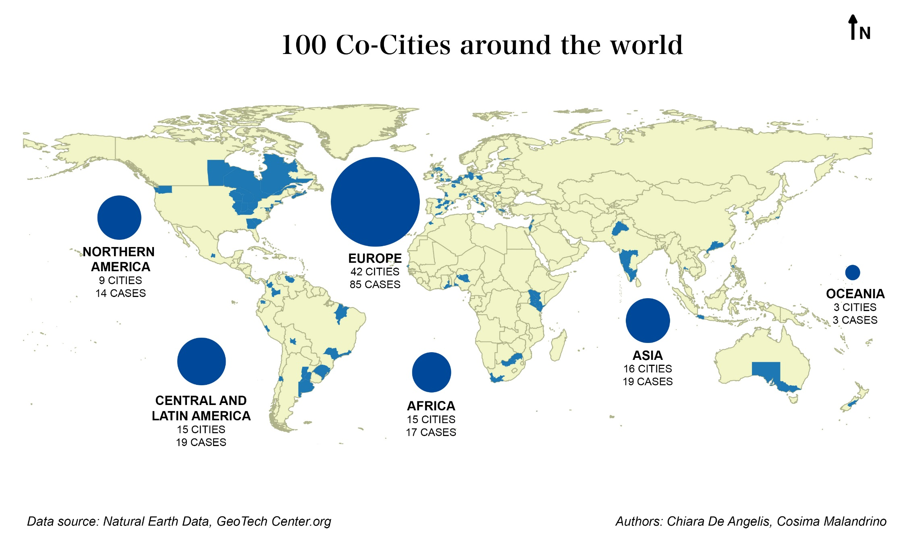

Slide 4
The Dataset

Slide 5
Analytical Framework: The City as a Commons
“City as a platform for sharing and collaboration, participatory decision-making and peer-to-peer production, supported by open data and guided by principles of distributive justice”
(Foster and Iaione 2016)

Slide 6
What is a Commons?
Garret Hardin’s Tragedy of the Commons:
Open access, unregulated resources result in overconsumption
Users are self-interested, rational actors who will not cooperate
Carol Rose’s Comedy of the Commons:
Open resources can result in solidarity, not tragedy— “the more the merrier”
Courts and laws protect open access, even if it is privately owned resource
Elinor Ostrom’s Collectively Governed Resources:
Users can cooperatively manage common pool resources
Under certain circumstances, users are able to design, enforce and monitor the rules for the resource (often by working with government agencies/public officials)
Constructed Commons:
Institutions designed for developing and sharing resources
Particularly for intangible resources such as knowledge, information, and culture
Infrastructure Commons:
Technological networks (e.g. micro grids, wireless broadband, collaborative transportation systems) and social infrastructure (e.g. schools, public housing, hospitals)
Public and Community-based actors pool their resources to deliver public services and essential facilities

Slide 7
What are Urban Commons?
Collectively managed or governed urban resources or services
Land and open space: parks, squares, community gardens, vacant lots
Infrastructure: streets, roads, abandoned railroads, abandoned buildings
Services: wireless, broadband, energy, transportation
Intangible aspects of cities : culture and heritage
Institutionalized sharing of resources or services
Urban residents are potential collaborators with public/private actors
Institutions designed to protect resources from enclosure (or to make more accessible or affordable existing resources)
State is a enabler or facilitator of collective governance/ new institutional forms
Public policies, legislation or formal coordination by public agencies
Transfer or sharing of resources: technical, financial, physical resources

Slide 8
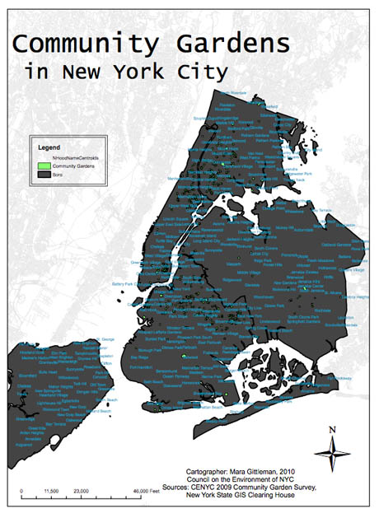
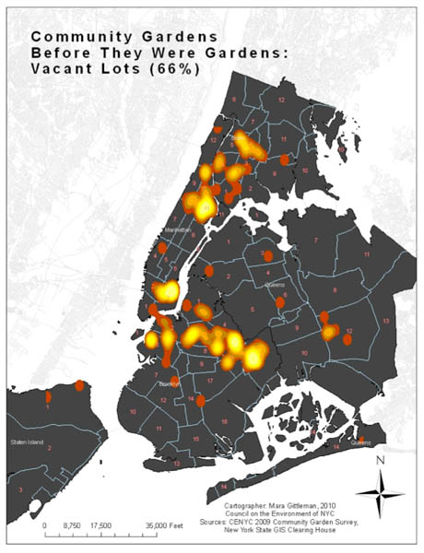
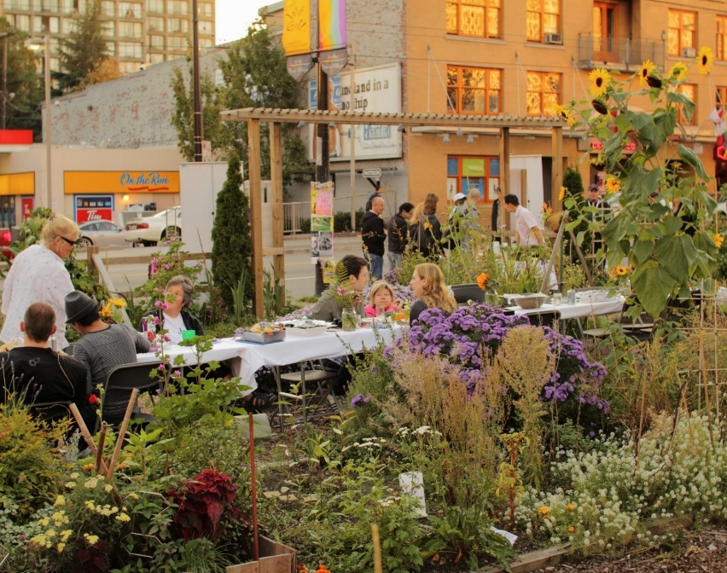

Slide 9
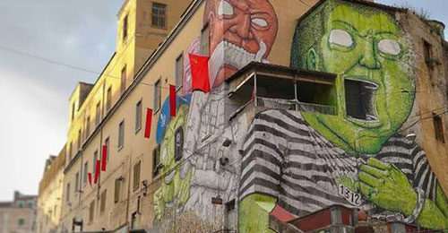
Ex OPG Je So Pazzo – Former Criminal Psychiatric Hospital – Civic Uses in Naples

Slide 10
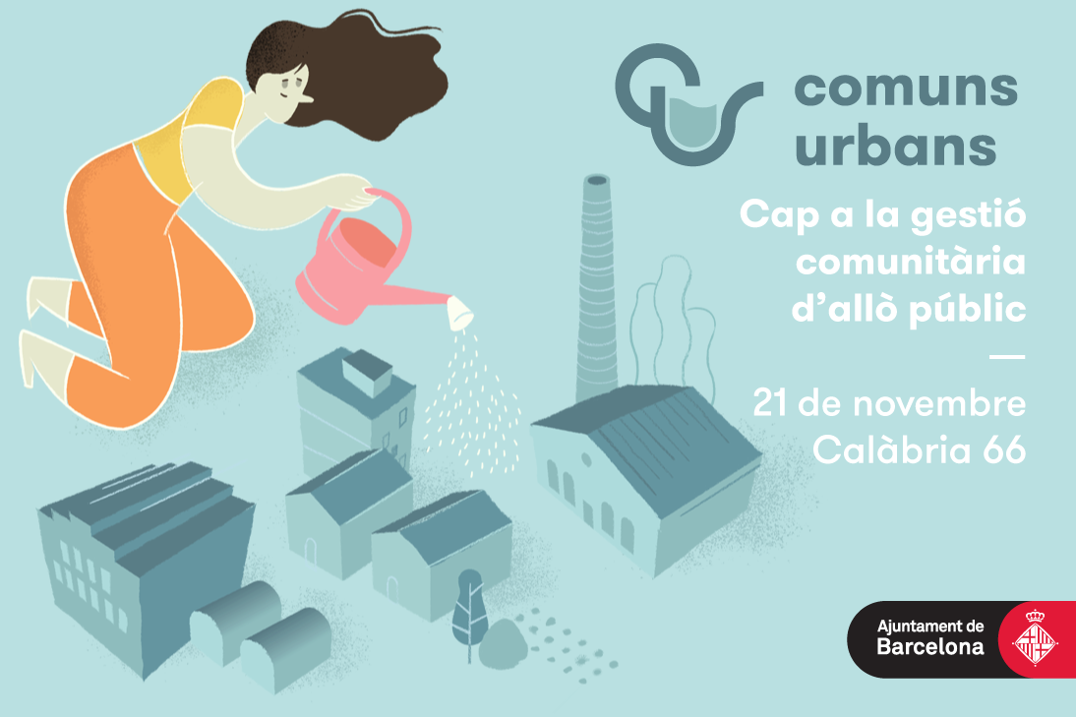

Slide 11
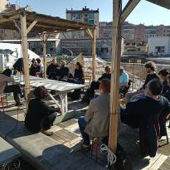
CO-CITY TURIN - THE COLLABORATIVE MANAGEMENT OF URBAN COMMONS TO COUNTERACT POVERTY AND SOCIO-SPATIAL POLARISATION

Slide 12
Community Land Trusts
Housing cooperatives have a long history in American cities (traceable to African American communities)
Use of CLTs separate land ownership from land use
Transform what might otherwise be a collection of individuals owning property (in the typical cooperative ownership model) into a
Collaboratively governed institution (“tripartite” board) to ensure affordability

Slide 13
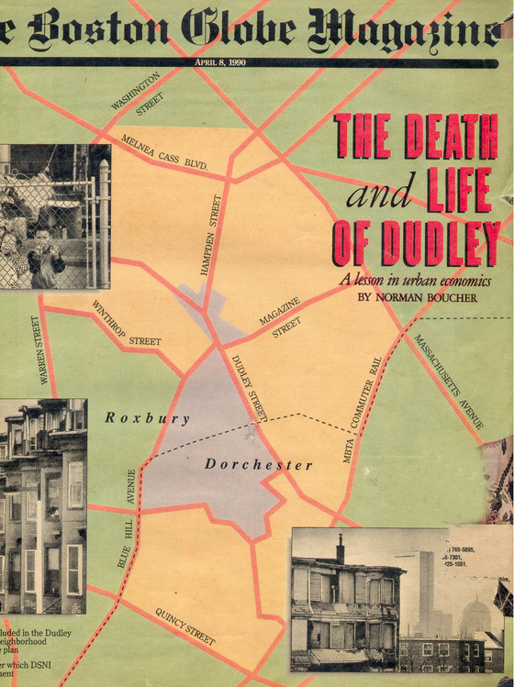
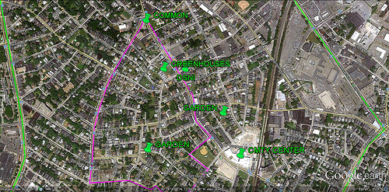
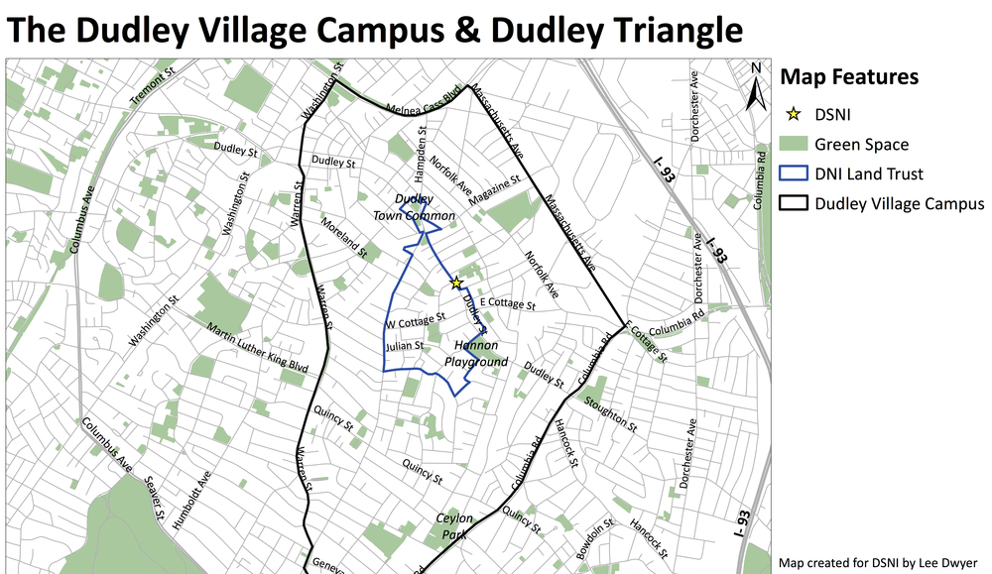

Slide 14
Community Wireless or Broadband Networks
“Mesh Networks” (Red Hook, Brooklyn; Spain, Greece, Italy, Latin America)
Open infrastructure; managed and governed by the community
Community Broadband (rural areas, low-income urban)
Addresses in part the digital divide
Even with “smart city” innovations such as LinkNYC (public high speed networks)
30% of households in Harlem, Bronx lack broadband access

Slide 15
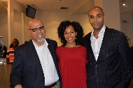
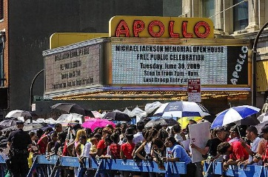
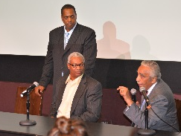
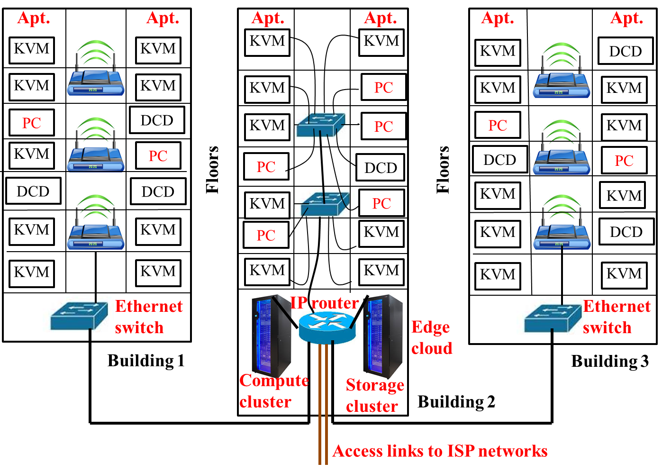
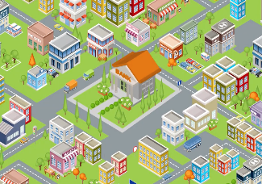
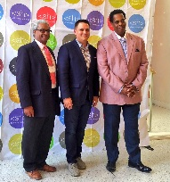
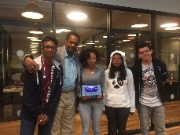
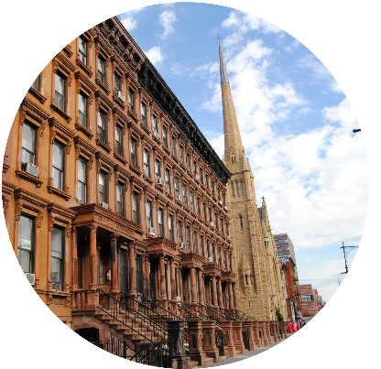
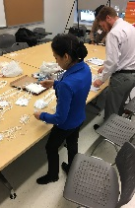
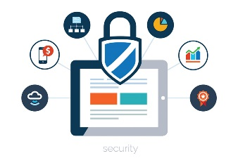
2018 NSF SMART AND CONNECTED COMMUNITIES PI MEETING
A Novel Architecture for Secure Energy Efficient Community-Edge-Clouds with Application in Harlem: SEEC Harlem, NSF Award #CNS-1737453
Dan Kilper¹ (Lead), Clayton Banks², Bryan Carter¹, Rider Foley³, Sheila Foster⁴, Bruce Lincoln², Olivier Sylvain⁵, Malathi Veeraraghavan³, Ron Williams³
¹University of Arizona (Lead), ²Silicon Harlem, ³University of Virginia, ⁴Georgetown University, ⁵Fordham University
http://cian-erc.uawebhost.arizona.edu/seec-harlem
Community Network + Edge Cloud
Community Engagement
Edge cloud to disaggregate hardware
Community network as digital constructed commons resource
Internet resources governance
Equitable benefits
Transferrable
Smart community education
CONNECTING HARLEM
Low cost, secure user devices
Shared, centralized IT management of high performance edge cloud
Where We Are
What’s Next
Kick-off at Silicon Harlem Conference 2017
Design and planning of edge cloud
Comp Case Studies
Public Trust Model
Microsoft/Cisco Hardware
Edge Cloud Design & Opt.
Community
Contributions
Technology Assessments
COSMOS
Performance evaluation: user experience
Co-Produced Edge Cloud
governance and business models:
Privacy, security
Gigabit Center
Initial ZeroClient Trial
100 User ZeroClient Trial
Apollo Theater Demo
School Demo
Community Apps & Demos
Zero Client Test Platform
EC-DC Software
Appl & VR Test Platform & SW
Public engagement/
participatory technology assessments (pTA)
Service Provider Contributions
Describe the aims of this project and how you plan to address them in collaboration with your community partners and in a specified community.
REQUIRED Graphical representation
of your approach, its place within the broader application domain, and interaction with the community.
Notes:
BRIEFLY INTRODUCE YOURSELF AND YOUR INVESTIGATORS (10 sec slide)

Slide 16
COVIOLO COMMUNITY-BASED WIRELESS NETWORK IN REGGIO EMILIA

Slide 17
Community Managed Micogrids
Use existing infrastructure and add advance technology to deliver or increase local energy production
EJ/climate justice groups have promoted in large cities
Can put in public housing or affordable housing buildings
Increase resiliency of low-income, vulnerable communities

Slide 18
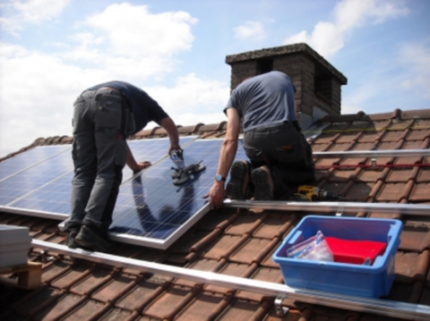
Energent – 500 Urban Commons Projects – Gent Commons Transition Plan

Slide 19
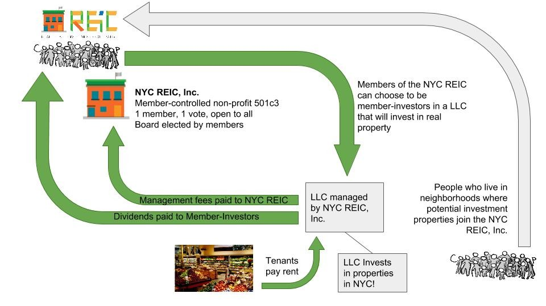
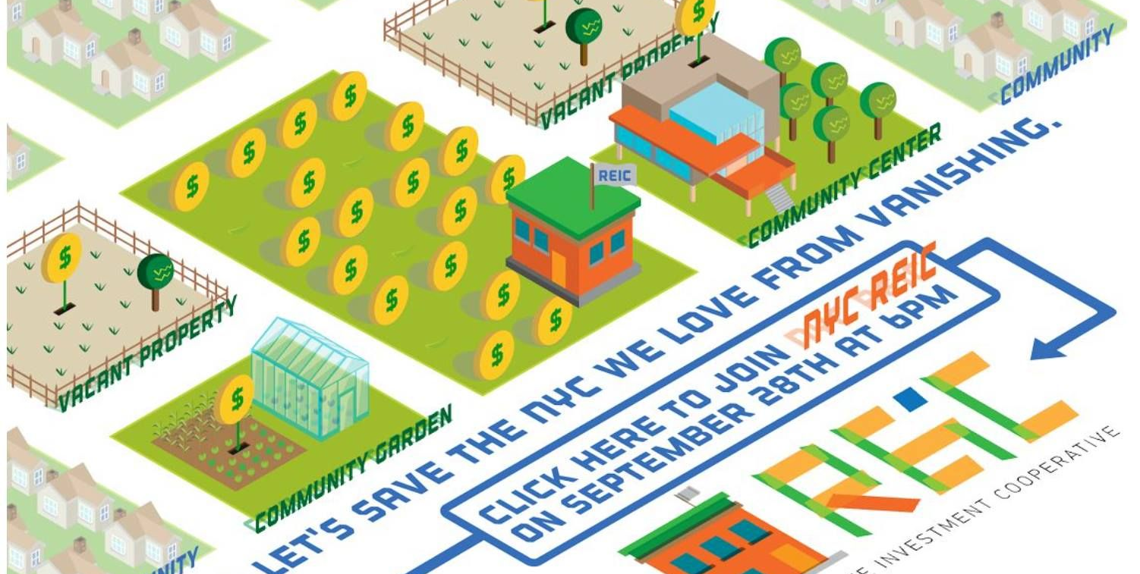

Slide 20
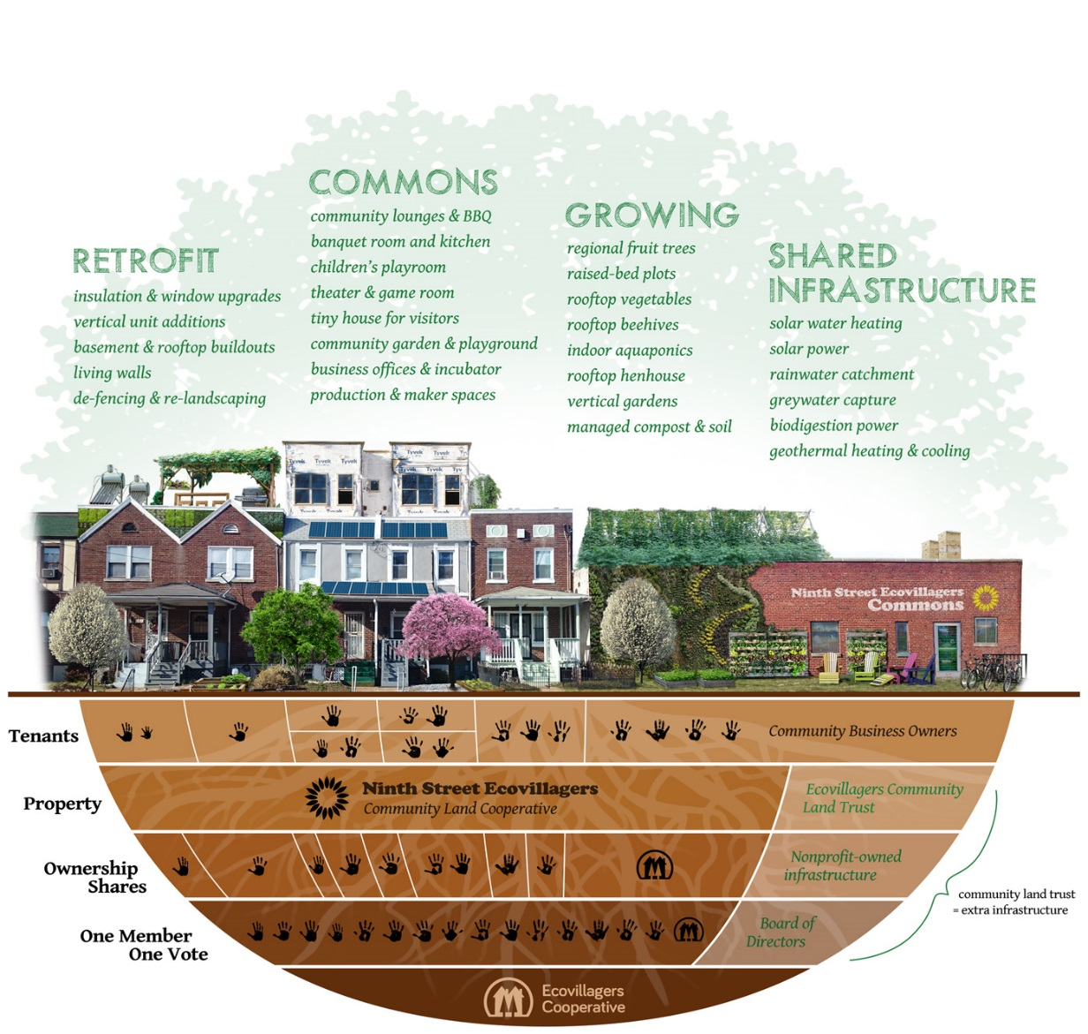

Slide 21
Working Hypothesis
Cities that have many constructed urban commons are those where there is an enabling state and presence of strong pooling economies

Slide 22
Institutional Design Principles

Slide 23
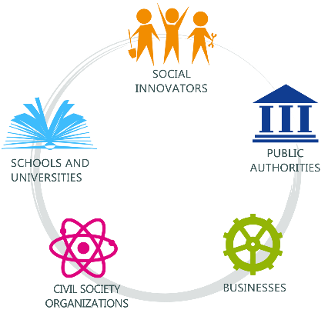
Co-Governance
Presence of independent institutions (formal/informal)
Collaboratively manage resource or service
Community (of users) partners with at least four other actors or sectors (“quintuple helix”)
Shared rules and/or norms (operational autonomy)

Slide 24
Enabling State
Public authorities facilitate or support creation
Sometimes technical, financial, infrastructure, legal tools
Can be key actor in co-governance regime or
Shadow actor (rights protection, dispute resolution)
“Nests” urban commons within overarching system of higher level rules or institutions

Slide 25
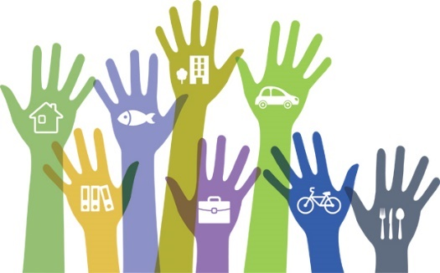
Social and Economic Pooling
Joining of different resources
Create new opportunities, goods, services
With characteristics of non-mainstream socio-economic system (e.g. peer to peer, mesh, collaborative, or circular resource system)
Directed towards underserved or vulnerable populations

Slide 26
Experimental
Institutional, legal or policy innovation
Context-specific, place-based
Iterative approach with replicability/scalability
Sunset provisions, feedback and evaluation mechanism

Slide 27
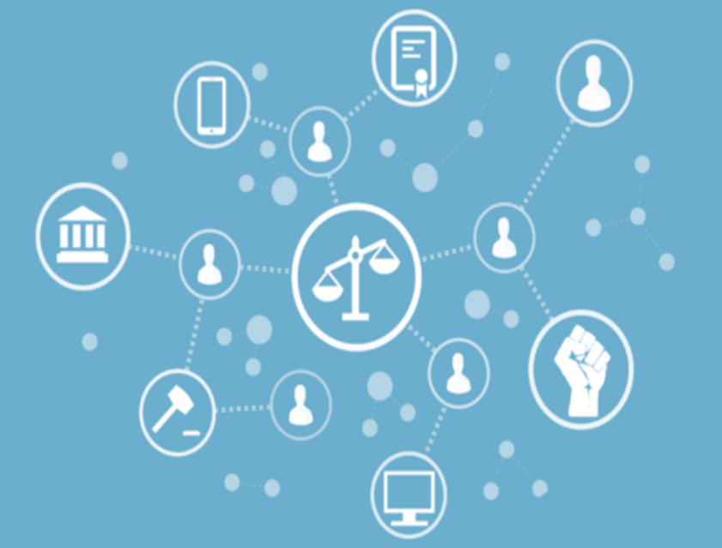
Tech Justice
Last mile connectivity to underserved populations
Collective ownership and/or management (community)
Open participation and access to network

Slide 28
Co-City Tools and Mechanisms
Institutional Mechanisms
Co-Design Laboratories (MindLab Denmark; Office of Civic Imagination Bologna; NYCx Co-Lab; Mexico City Lab for the City)
Neighborhood Level Cooperative Development Agencies (Regies des quartier/Paris; Pilastro Development Agency/Bologna; Collective Economy “Urban Villages”/Seoul, London, Shenzhen)
Networked Co-Governance: Neighborhood Houses/Turin, Berlin; Abit@Giovani/Milan; Neighborspace/Chicago)
Enabling Legal Reforms
Public-Community Pacts of Collaboration: (Bologna Regulation on the Urban Commons )
City Sponsored Community Land Trusts : (NYC Dept of Housing; San Juan Puerto Rico informal settlement)
Urban Civic Uses (City of Naples ordinance; UK Localism Act)
Collaborative Digital Platforms
Decidem/City of Barcelona
SynAthina/City of Athens
Iperbole/City of Bologna

Slide 29
The Co-City Cycle
The Co-City Cycle is designed to create the most favorable environment for experimentation using the design principles to innovate urban policies and institutional frameworks
The key is to transform cities/neighborhoods into laboratories for commons-based governance solutions

Slide 30
The Co-City Cycle
Phase 1: Cheap Talk
Understand the objectives of your collaborators and partners.
Phase 6: Testing
Design and execute a framework to test your prototype. Ensure you are adapting it at regular intervals to be more useful, based on community feedback.
Phase 5: Modeling
Identify the legal requirements and adjustments needed to make your prototype possible. Implement these changes.
Phase 2: Mapping
Identify the needs, challenges, and opportunities of the community you are seeking to serve.
Phase 3: Practicing
Generate ideas and share them with users for feedback.
Phase 4: Prototyping
Develop a clear and detailed concept of one way to support the community.
V1 12/17

